Slide 1
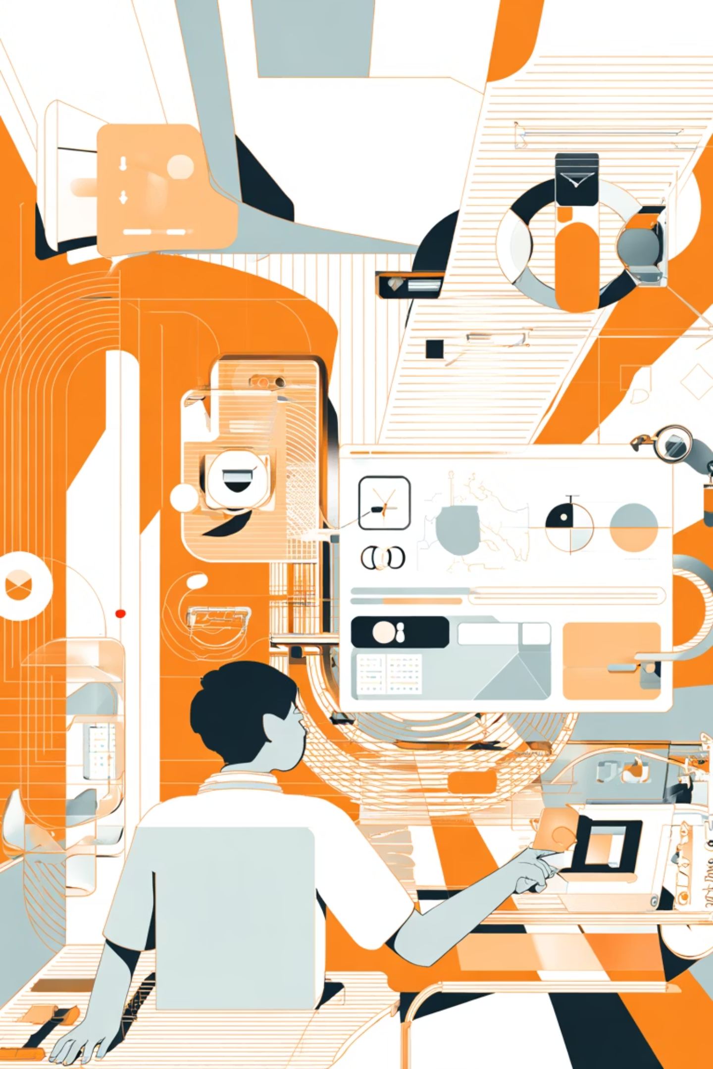
Super Study App
The AI-Powered Ecosystem Redefining How Students Learn, Work & Grow
Your Cognitive Growth Companion

Slide 2

Today's Learners Are Overwhelmed
Modern learners face an unprecedented challenge: managing their education and career preparation across fragmented digital ecosystems that drain their time and energy.
Tool Overload
Students juggle 6+ disconnected apps daily for study, tasks, and interview preparation
Productivity Drain
Hours lost to context switching and app fatigue, destroying focus and momentum
Growth Gaps
No personalised feedback, guided development, or insight into communication behaviours

Slide 3
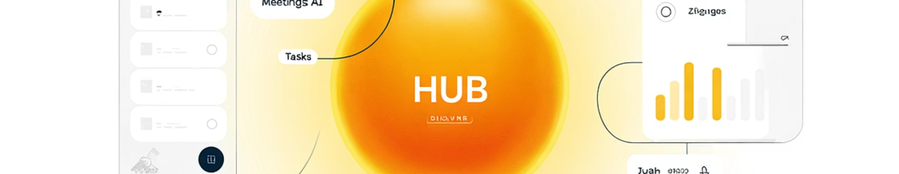
From Fragmentation to Flow
Super Study App unifies every element of learning, productivity, and personal growth into one intelligent system that evolves with you.
"One ecosystem that learns from you, adapts with you, and grows for you."
We're not building another productivity tool — we're architecting a cognitive operating system that eliminates the chaos and amplifies human potential.

Slide 4
All Your Tools. One Intelligent Space
Smart Task Engine
Integrated Workspace
Unified Storage
Dream-to-Plan AI
AI-powered task and note management with OCR capabilities that understand your handwriting and images
Code execution, digital journalling, intelligent flashcards — all in one seamless environment
Google Drive synchronisation with smart document processing and instant accessibility
Revolutionary technology that converts spontaneous thoughts into actionable, structured goals
Turning ideas into outcomes — effortlessly.

Slide 5





From "I Wish" to "I Did"
Dream-to-Plan AI
Capture Dreams
Our breakthrough innovation bridges the gap between imagination and execution. Journal your aspirations, voice your ambitions, or simply brainstorm — and watch as our AI transforms them into structured, trackable action plans.
Voice notes, journal entries, or spontaneous ideas
AI Analysis
Intelligent parsing of intent, goals, and requirements
This isn't task management. It's aspiration architecture.
Structured Plans
Actionable steps with timelines and milestones
Track Progress
Adaptive guidance as you execute your vision
"The first AI system that bridges imagination and execution."

Slide 6

Never Miss a Thought Again
AI Scribe & Meeting Intelligence
Transform every conversation into actionable intelligence. Our AI listens to your meetings, lectures, and discussions — transcribing, summarising, and automatically generating prioritised to-do items.
Real-Time Transcription
Intelligent Summaries
Accurate capture of every word spoken
Key points extracted automatically
Action Automation
Decision Intelligence
Tasks generated and routed instantly
Strategic insights from discussions
"Turns every discussion into decisions."
Integrated with advanced automation workflows, ensuring insights flow seamlessly into your productivity ecosystem.

Slide 7
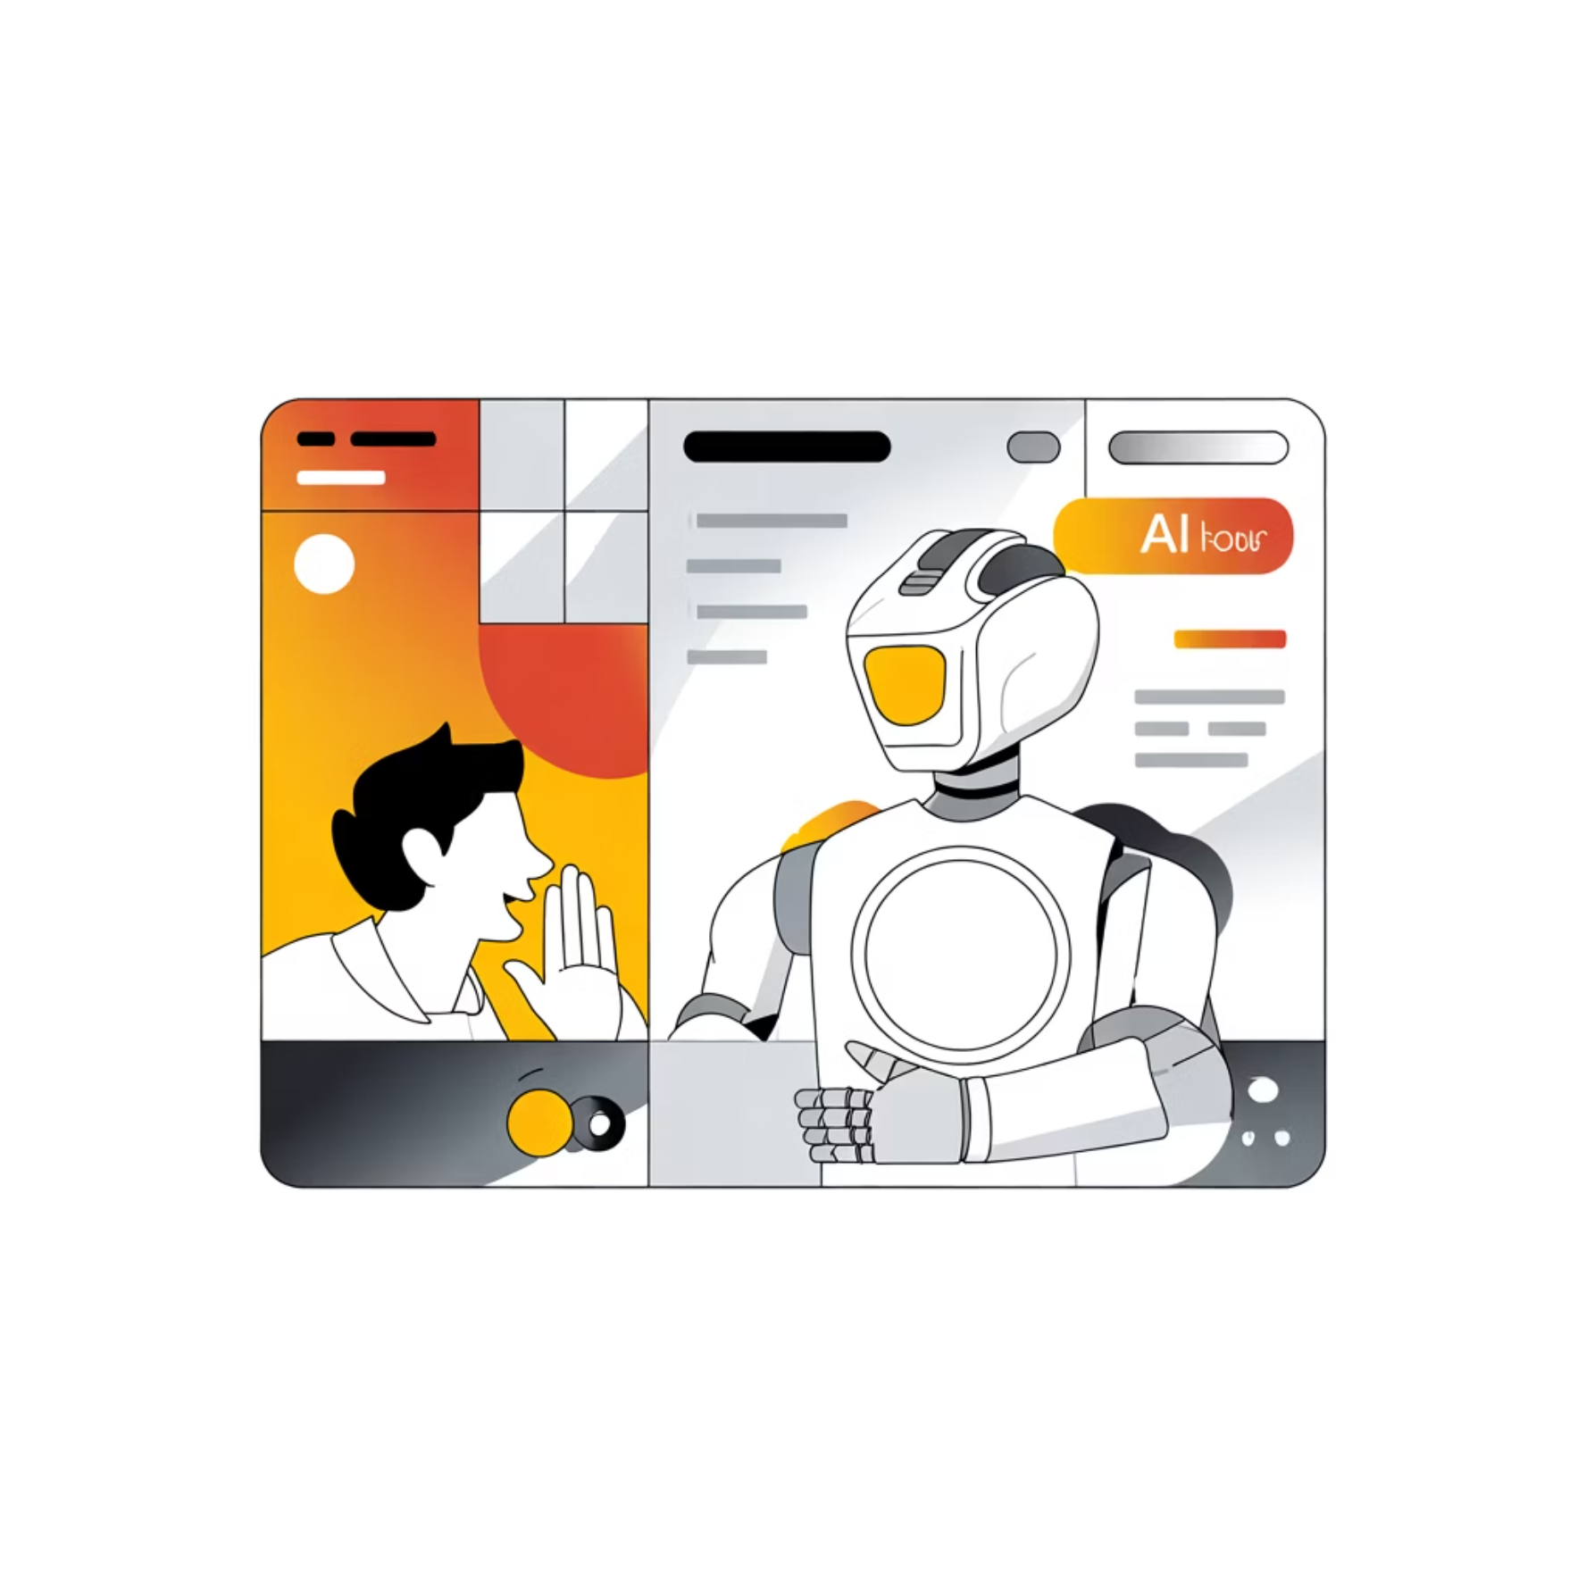
Interview Like a Pro — Instantly
Real-Time Interview Intelligence
Revolutionary multimodal AI analyses your speech tone, filler words, facial expressions, and posture in real time — providing instant feedback that transforms communication skills.
01
Live Behavioural Analysis
Speech patterns, tone, body language tracked simultaneously
02
Adaptive Questions
AI generates follow-ups based on detected weak points
03
Confidence Scoring
Real-time metrics on clarity, conviction, and presence
04
Personalised Feedback
Actionable insights delivered instantly after each session
A revolution in self-awareness and communication mastery

Slide 8






Your Growth, Quantified
Cross-Feature Intelligence & Behavioural Analytics
Every activity you perform — study sessions, planning exercises, journal entries, focus blocks — feeds into a unified AI intelligence model that reveals hidden patterns and accelerates your development.
Planning Behaviour
Learning Activities
Goal-setting analysed
Study patterns tracked
Reflection Insights
Journal data processed
Growth Synthesis
Evolution visualised
Cognitive Patterns
Focus metrics measured
Example: Your focused study sessions improve your interview clarity scores by 23% — the system shows you exactly how your habits compound into capabilities.
"Turns learning into measurable evolution."

Slide 9
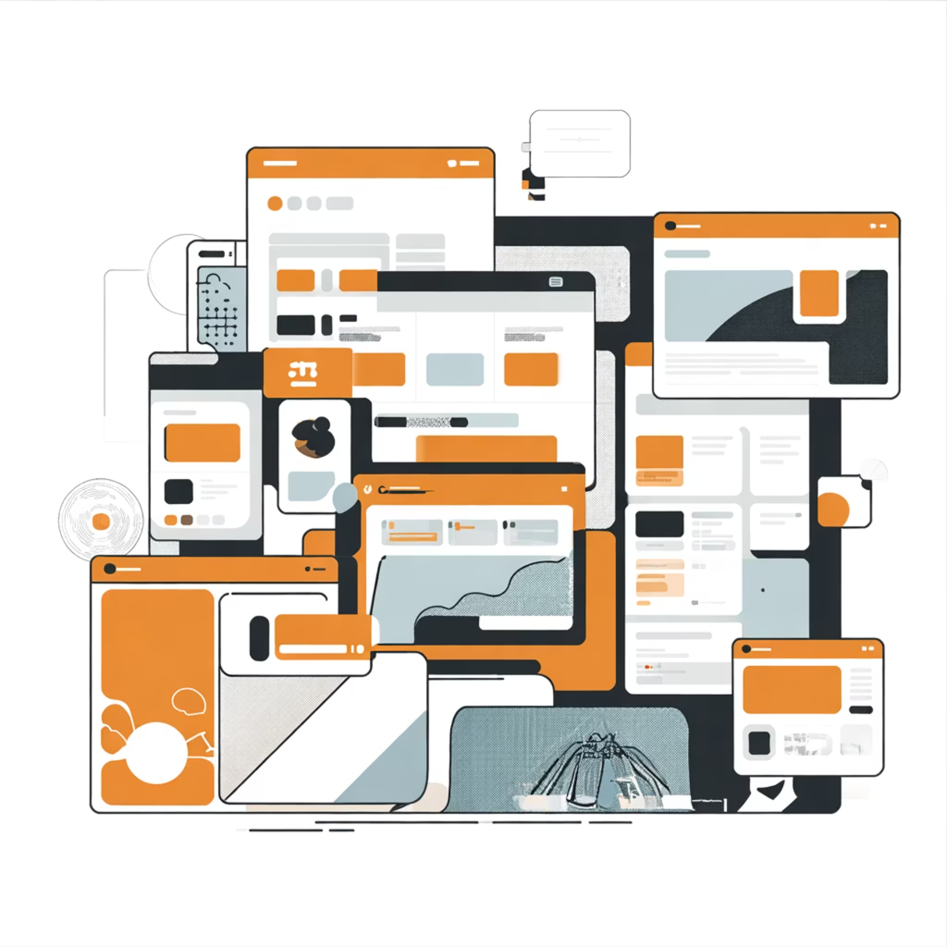

Not Another Productivity App — A Category Redefinition
Before Super Study App
After Super Study App
6+ fragmented tools
One unified ecosystem
Constant context switching
Seamless cognitive flow
No intelligent feedback
Real-time AI guidance
Reactive, not proactive
Predictive and adaptive
Data silos everywhere
Holistic growth intelligence
85%
3x
6+
Time Saved
Faster Learning
Apps Replaced
Through tool consolidation
With AI-driven insights
One comprehensive solution
"We don't compete — we replace the category."

Slide 10
The Future of Learning Starts Here
Super Study App isn't just solving today's problems — we're architecting tomorrow's learning experience. An ecosystem where artificial intelligence amplifies human potential, where fragmentation gives way to flow, and where every student has a cognitive companion guiding their journey.
Dream-to-Plan AI
Meeting Intelligence
Transform aspirations into action
Never lose a valuable insight
Interview Mastery
Growth Analytics
Real-time multimodal feedback
Quantified personal evolution
Join the Revolution
One app. Infinite possibilities. Your cognitive growth companion.

